Slide 1
FINAL PROJECT JCL, vsam, COBOL & DB2
PRESENTATION BY: SUNKARA HARSHA

Slide 2
GDGCRT
STEP 1
STEP 2
STEP 3
TAKE INPUT PS
DEFINE GDG CLUSTER
BACKUP RECORDS FROM INPUT PS TO GDG

Slide 3
COBPGM
EXTRACT HOUSING LOAN DATA FROM INPUT PS
VALIDATE THE RECORDS
If INVALID
BACKUP THE INPUT FILE TO GDG
WRITE THE RECORDS INTO ERROR PS WITH REJECTED REASON
If VALID
CALCULATE THE NEXT REPAYMENT DATE AND BALANCE AMOUNT
INSERT THE RECORDS INTO APPLICANT_DB AND LOAN_DB

Slide 4
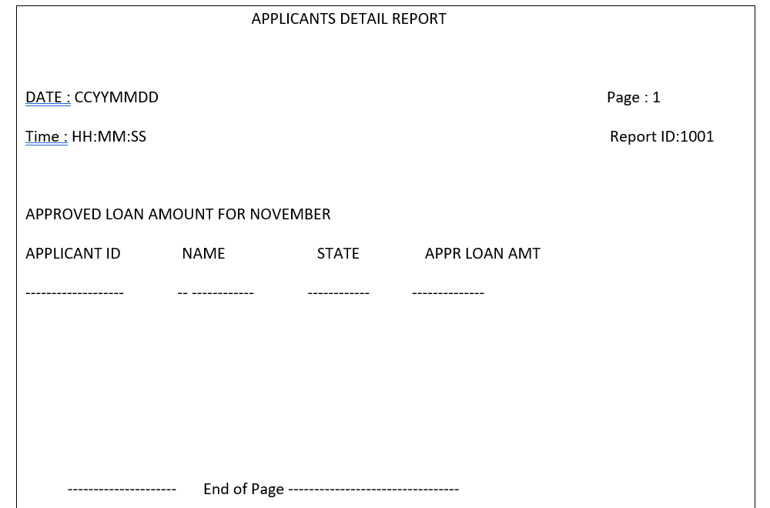
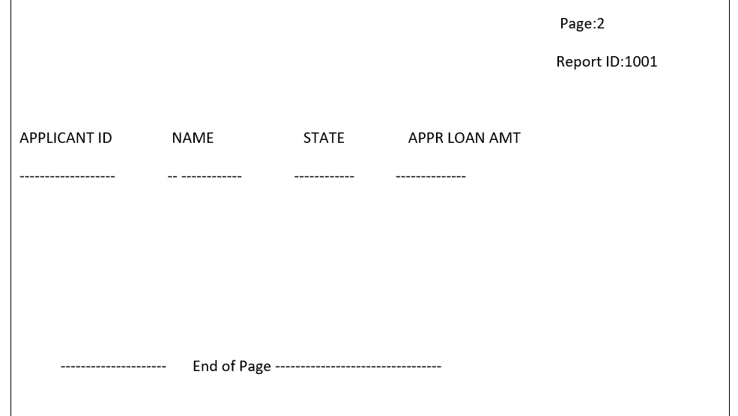
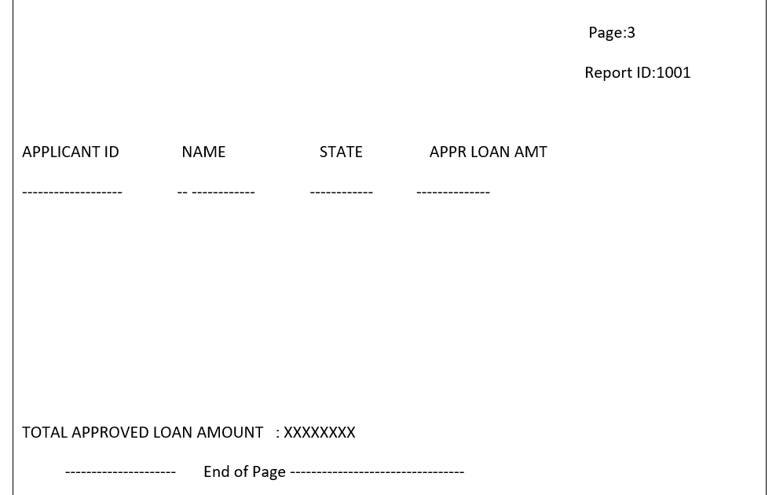
REPPGM
EXTRACT HOUSING LOAN DATA FROM APPLICANT_DB AND LOAN_DB
FETCH RECORDS FROM CHENNAI LOCATION AND NOVEMBER MONTH
GENERATE A SEPARATE REPORT FILE USING PAGE BREAK LOGIC

Slide 5
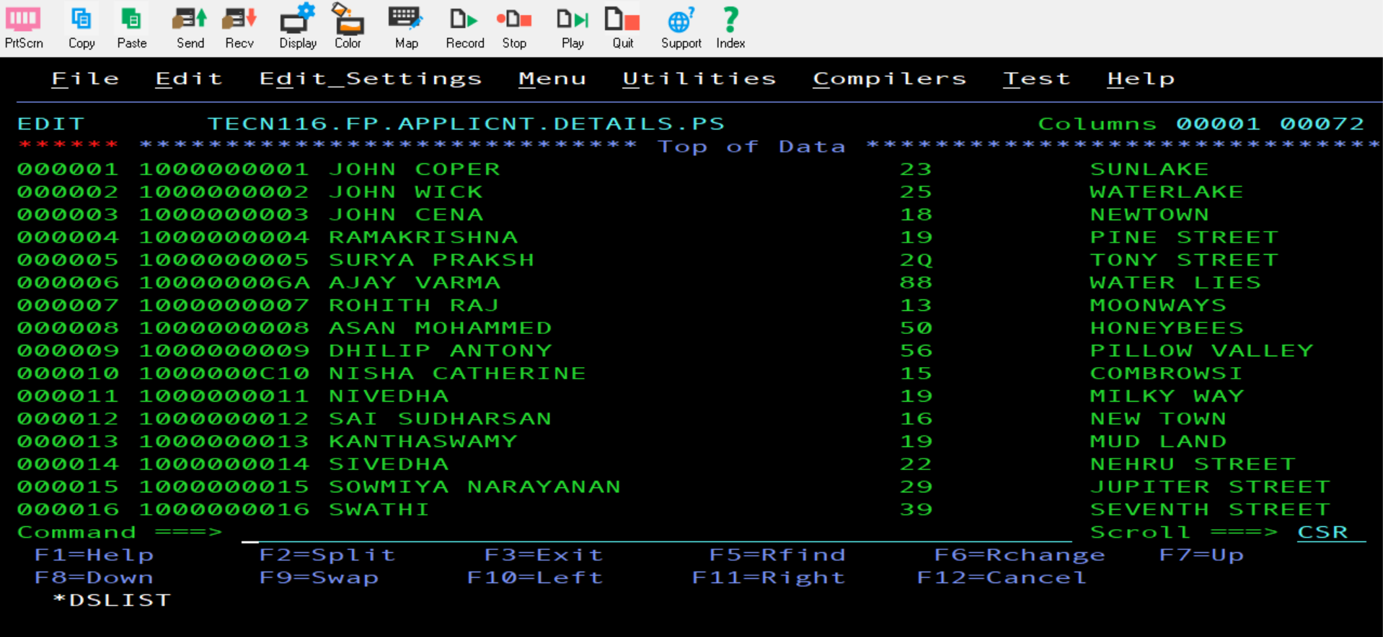
INPUT FILE

Slide 6
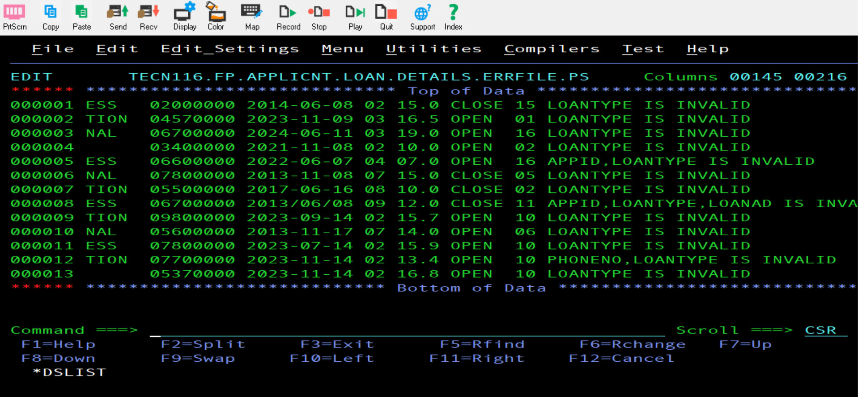
ERROR FILE

Slide 7
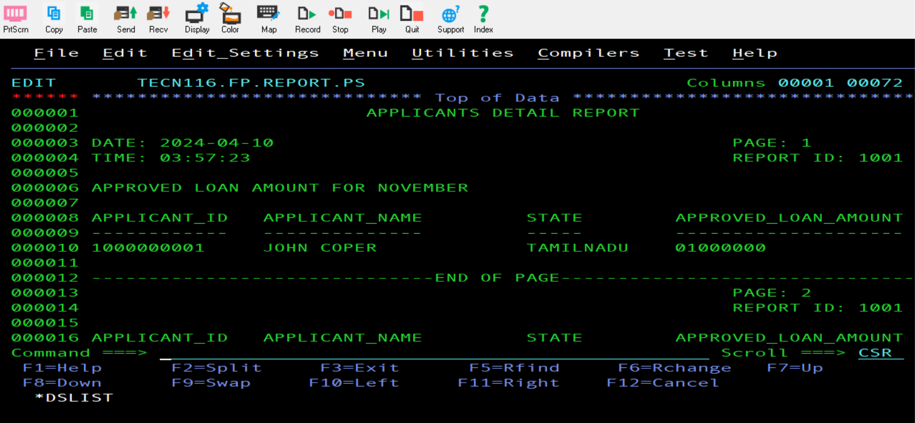
REPORT FILE

Slide 8
THANK YOU

